Slide 1

AAROGYA
Empowering Mothers, Nurturing Futures
by Team Weber
Stronger Moms,Healthier Babies

Slide 2

The Hidden Crisis in Postnatal Care
Every year, thousands of new mothers and babies in India face preventable health complications during the critical postnatal period. The transition to motherhood brings unique physical and mental health challenges that often go unaddressed.
Limited access to continuous healthcare monitoring, lack of immediate emergency support, and insufficient guidance on traditional practices create dangerous gaps in postnatal care.
This crisis affects both urban and rural communities, with rural areas facing additional barriers to healthcare access and technological solutions.

Slide 3


The Problem Statement
Critical Gap in Postnatal Healthcare
New mothers lack continuous health monitoring systems for both themselves and their babies, leading to delayed detection of complications and inadequate emergency response during the crucial postnatal recovery period.
The absence of integrated tracking systems, emergency protocols, and family communication channels puts both maternal and infant health at serious risk during the most vulnerable weeks after birth.

Slide 4

Alarming Statistics
45,000
28
70%
Maternal Deaths
Critical Days
Rural Impact
Annual maternal deaths in India, many preventable with proper postnatal monitoring
First 28 days are most crucial for newborn survival and maternal recovery
Of maternal deaths occur in rural areas with limited healthcare access

Slide 5

Challenges Faced by Mothers
Delayed Detection
Isolation
Health complications in mothers and babies often go unnoticed until they become critical emergencies
New mothers struggle with mental health issues without adequate family support and professional guidance
Emergency Response
No immediate access to healthcare professionals during medical emergencies in remote areas

Slide 6

Real-World Impact
"When my baby developed fever at 3 AM, I had no idea whom to call. The nearest hospital was 20 kilometres away, and my family panicked. We needed immediate guidance and support."
- Priya, New Mother from Rural Maharashtra
Stories like Priya's highlight the urgent need for accessible, technology-driven solutions that bridge the gap between healthcare providers and families during critical postnatal periods.

Slide 7
Existing Solutions Fall Short
Traditional Healthcare Apps
Government Programmes
Private Healthcare
While well-intentioned, programmes like Janani Suraksha Yojana focus primarily on delivery, not comprehensive postnatal monitoring
Expensive and inaccessible to rural populations, lacking continuous monitoring capabilities
Generic health apps lack specialised postnatal features and emergency protocols specific to mother-baby care

Slide 8

Limitations of Current Approaches
Technology Gaps
Accessibility Issues
No integrated mother-baby health tracking
Urban-centric design approach
Lack of emergency alert systems
High cost barriers
Complex user interfaces
Missing family communication features
Limited regional language support
No traditional practice guidance(future expansion)

Slide 9

Introducing AAROGYA
AAROGYA is a comprehensive postnatal care platform designed specifically for Indian mothers and babies, combining traditional wisdom with modern technology.
01
Dual Health Tracking
Monitor both maternal and infant physical and mental wellbeing with intelligent alerts
02
Emergency Response
Instant connection to ASHA workers and healthcare professionals during critical situations
03
Family Integration
Live health updates for chosen family members ensuring comprehensive support system
04
Smart Insights
Scientific explanations for traditional practices with personalised nutrition tracking

Slide 10
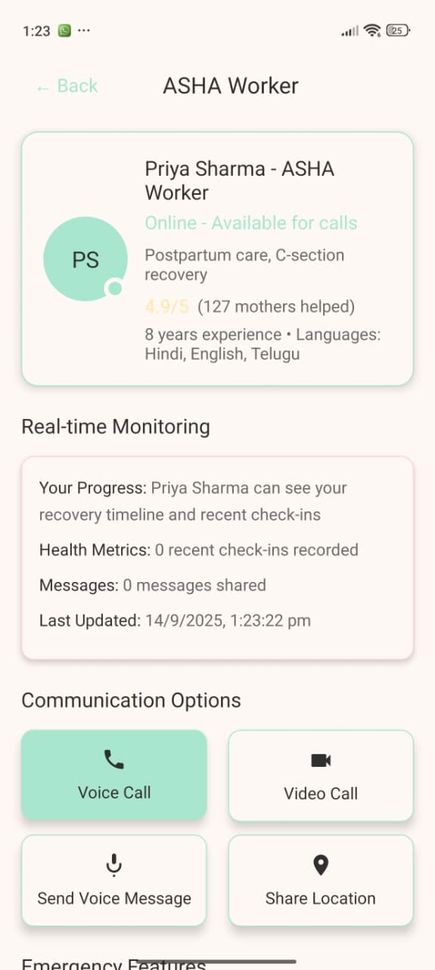
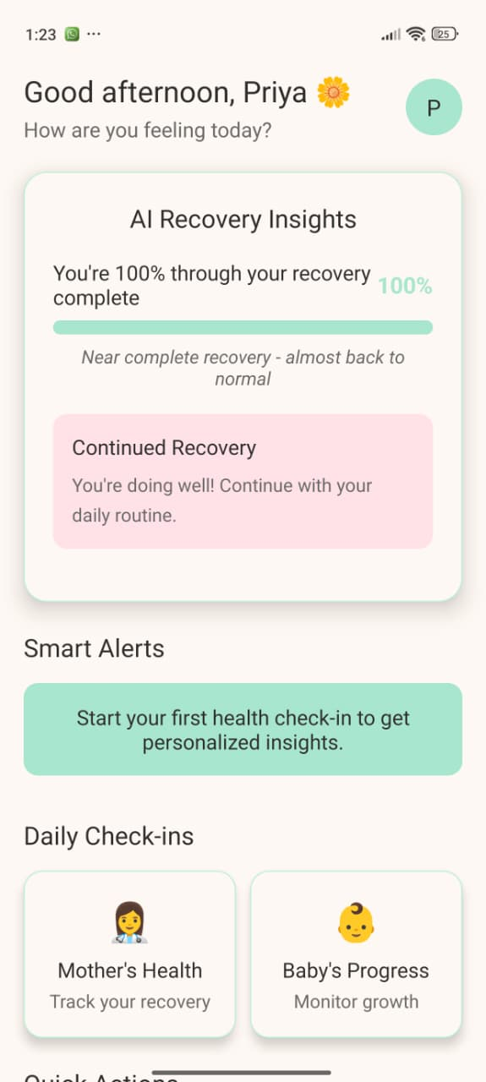

Experience AAROGYA in Action
Main Dashboard
Emergency System
Ready for Live Demonstration
Watch our interactive prototype showcase the red flag alert system, nutrition tracking, and family communication features that make AAROGYA the comprehensive solution for postnatal care.
Future Expansion: SMS system for rural areas and integrated doctor's dashboard for preventive care

Slide 11
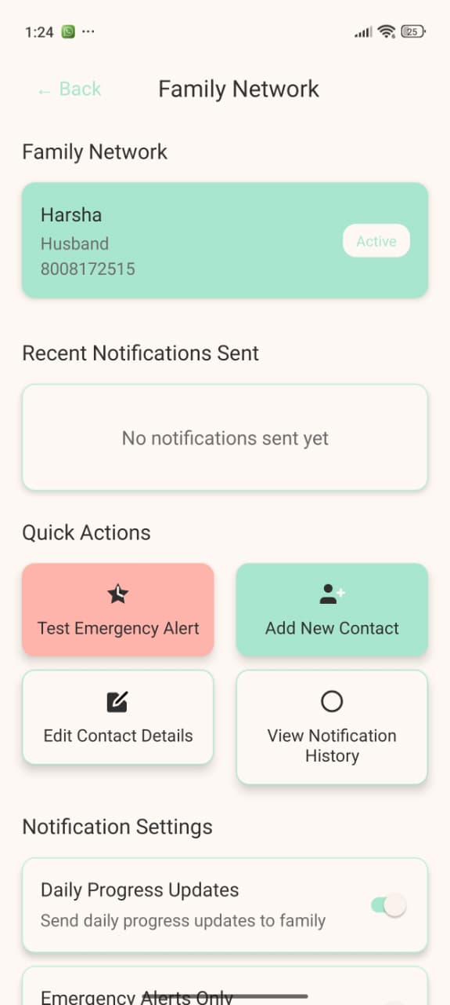
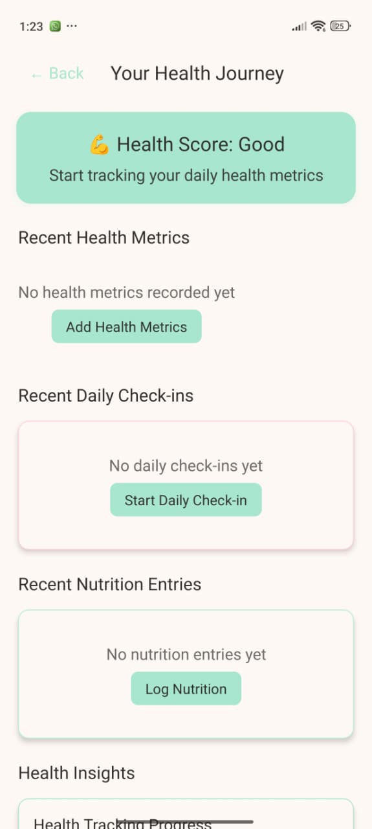
AAROGYA: Comprehensive Care for Mother & Baby
AAROGYA provides holistic postnatal support, focusing on both the physical and mental well-being of new mothers and their infants. Our intuitive app offers personalized tracking, emergency assistance, and culturally relevant guidance to ensure a healthy start for every family.
Holistic Tracking & Insights
Seamlessly monitor vital aspects of both mother's recovery and baby's development, from physical milestones to emotional well-being.
Emergency SOS & Family Updates
Instant connection to ASHA workers for urgent support and real-time health updates for chosen family members, fostering a strong support network.

Slide 12
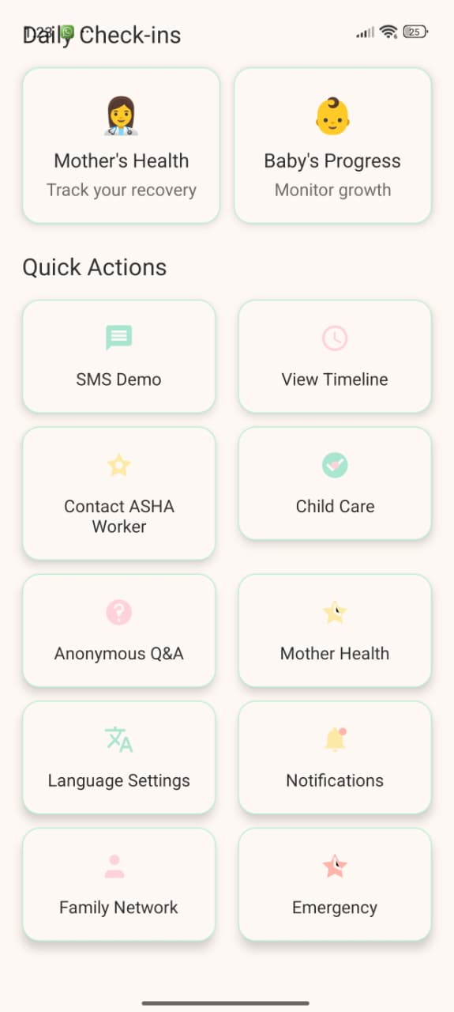
Innovative Features for a Seamless Journey
Personalized Nutrition Tracking
Tailored dietary recommendations and tracking to support mother's recovery and lactation, ensuring optimal health for both.
Cultural Wisdom & Scientific Backing(Future expansion)
Dashboard pop-ups explain the scientific basis behind traditional postnatal practices, bridging ancient wisdom with modern science.
Red Flag Early Warning
An intelligent system that identifies potential health concerns based on user input, enabling timely intervention and care.

Slide 13






Market Potential: A Growing Opportunity
Digital Health & FemTech Boom
Global FemTech projected to exceed $100B by 2030. Parenting and baby care apps already a $3-5B market with double-digit CAGR.
Global New Mothers
~140 million babies born annually worldwide. India alone contributes ~25 million, representing a massive market of first-time mothers seeking digital guidance.
Untapped Postpartum Gap
Over 70% of apps focus on pregnancy, leaving postpartum emotional health, recovery, and combined mom-baby guidance largely unaddressed.

Slide 14




Scalability: Reaching Every Mother
Tiered Expansion
Starting with tech-savvy urban Indian mothers, then expanding to semi-urban and rural areas with localized interfaces, and finally global rollout.
Diverse Revenue Models
Freemium model, partnerships with hospitals and maternity brands, and a curated community marketplace for mom-baby products.
Robust Tech Infrastructure
Cloud-native architecture and AI personalization ensure seamless scalability to millions of users without significant cost per user.

Slide 15

Our Competitive Advantage
Holistic Approach
Unlike fragmented solutions, AAROGYA integrates physical, mental, and social well-being for both mother and baby.
Cultural Sensitivity
Bridging traditional practices with scientific explanations fosters trust and adoption within diverse communities.
Integrated Support Network
Direct access to ASHA workers and family updates creates a crucial safety net for new mothers.
Data-Driven Early Intervention
Our red flag system offers proactive health management, preventing complications before they escalate.

Slide 16




Overcoming Challenges
Awareness & Adoption
Extensive campaigns in rural and semi-urban areas to educate mothers on the benefits of digital health.
Digital Divide (SMS System)
Future expansion to include SMS-based updates for the 6% of rural women without smartphones, ensuring inclusivity.
Localization
Adapting UI and content to local languages and cultural nuances for broader acceptance.

Slide 17



Future Enhancements & Impact
Community & Expert Forums
Advanced AI Analytics
Doctor's Dashboard
Leveraging AI for predictive analytics to identify mothers and babies at higher risk, enabling proactive support.
Integrating forums for peer-to-peer support and direct consultation with medical professionals.
Developing a dedicated dashboard for healthcare providers to monitor patients, receive alerts, and provide instant, preventive care.

Slide 18

Join Us in Nurturing New Beginnings
AAROGYA is more than an app; it's a commitment to empowering new mothers and safeguarding the health of the next generation. Our vision is a world where every mother feels supported, informed, and confident through her postnatal journey.
"The journey of a mother is sacred. AAROGYA is here to protect it."

Slide 19

Thank You!
Team Weber

